Slide 1
Understanding ECFramework…
MicroStation CONNECT Edition SDK Training
Bentley Systems, Inc.
Notes:
Hello everyone! Today, we will learn about ECFramework core concepts.

Slide 2

Mangesh Shelar
Senior Manager, Software Development
Microstation and PowerPlatform team.
Bentley.com
Developer.Bentley.com
twitter.com/MicroStation
facebook.com/MicroStation
linkedin.com/in/mangeshshelar2020/
youtube.com/channel/UC1G4bUAnMFhDvkKu3kqHKUg
Notes:
I am Mangesh Shelar. I am a Senior Manager, Software Development for MicroStation and PowerPlatform team.
Here are some important links which will help you, to get started quickly. I recommend Developer.Bentley.com – it is mainly built for Software Developers.

Slide 3
Why do we must know EC?
EC is strategic throughout BSW.
Microstation CE property system
i-models, iModel
OpenPlant, Civil frameworks
And many more…
Notes:
Why do we must know EC? EC stands for engineering content. All engineering information including business properties or domain specific properties, are stored and presented in DGN or any other data store, in EC format. So, whether you are MicroStation CE user or working with i-models or iModelHub or vertical products like OpenPlant, Openroads etc. and you want to deal with business properties, you must know EC.

Slide 4
ECFramework 2.0 Overview
Applications
Components
ECControls
Other Platform Libraries
ECServices
(Repository-independent API for objects and files)
ECObjects
ECPlugins
(Adapters for specific types of ECRepositories like DgnECPlugin)
ECXML
Repository-specific APIs
DgnECManager (native)
ECRepositories
DGN File
Native ECObjects
Notes:
In CONNECT Edition, the framework EC offers is version 2.0, and we term it as EC 2.0.
ECXML is xml representation of EC data. Then we have native ECObjects and Managed ECObjects.
DgnEC native APIs are based on native ECObjects.
And DgnEC managed APIs, DgnECPlugin, EC controls like Property Pane, Explorer, EC grid used managed ECObjects.
In this training, we will be focusing on EC concepts that are mainly needed while dealing with Microstation.

Slide 5
EC Core Concepts
Notes:
Lets see EC core concepts in detail.

Slide 6
There is no such thing as an “ECObject”
“Object” is ambiguous
ECClass defines an object
ECInstance is an instance of an object
“ECObjects” refers to both concepts (and related)
ECInstance ~ Entity
ECClass ~ EntityType
ECProperty ~ Attribute Definition
ECPropertyValue ~ Attribute Value
Notes:
There is nothing like physical ECObject. It’s rather a concept.
ECClass, is skeleton of your data, is Entity Type, and defines an object.
ECInstance is an instance of an object, instance of your ECClass.
ECProperty is an attribute in your ECClass and ECPropertyValue is attribute value.
So ECObject is concept revolving around ECClass -> ECInstances, ECProperty -> ECPropertyValue.

Slide 7
Data Abstractions
ECInstance
References ECClass
Has InstanceId
Holds ECPropertyValues
ECPropertyValue
References ECProperty
Holds a value
Can be NULL
ECRelationshipInstance
Is an ECInstance (may have ECPropertyValues)
Has 1 “source” and 1 “target” ECInstance
Pump
(InstanceId=47)
ECClass: Pump
AssetTag (string)
Manufacturer (string) PressureDrop (double)
Flowrate (double)
P-101
GE 4.5
9.7
Notes:
Here is the example.
ECClass Pump is skeleton. It has two string ECProperties (AssetTag and Manufacturer) and two double properties (PressureDrop and Flowrate).
Using EC APIs, we will create an object of it. It will be termed as ECInstance. So *Pump* is an ECInstance of Eclass:Pump.
This Pump ECInstance will have unique InstanceId and it holds ECPropertyValues.
AssetTag ECPropertyValue in Pump ECInstance references AssetTag ECProperty in ECClass Pump and it holds value “P-101”.
We will see more of ECRelationship instances in coming slides.

Slide 8
Metadata abstractions
ECSchema—just a collection of ECClasses
ECSchemaReference—reference other ECSchemas
ECClass—holds ECProperties
ECProperty (definition)—Name, datatype, etc.
ECStructProperty—embedded struct
ECArrayProperty—array of primitives or structs
ECRelationshipClass—an ECClass that defines relationship
ECCustomAttribute—custom metadata on ECSchema, ECClass, or ECProperty
Notes:
So, these are the core concepts we will encounter many times in EC related training like DgnEC CRUD, ItemTypes, Expressions etc.
ECSchema is collection of our ECClasses. If your schema references to some other schema, you need to mention ECSchemaRefrerence to that schema.
ECProperty, which we saw in previous slides, can support array and structures. EC relationships offers a way to establish relationship between two ECInstances.
And, ECCustomAttriubtes offers a way to define custom metadata for ECSchema, ECClass or ECProperty.

Slide 9
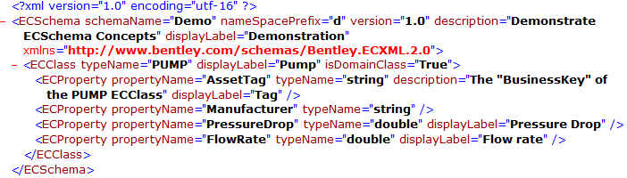
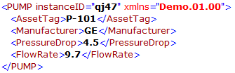
ECXML is two different XML formats…
ECSchemaXML for the metadata.
ECInstanceXML for the data.
ECInstanceXml contains no metadata… just a name for looking the extensible metadaupta.
Notes:
Let’s have a close look to ECXML representation of our ECSchema.
Here, our SchemaName is “demo” namespace prefix is “d”. If you define new schema say “newDemo” and refer “demo” schema there, then to access entities of “Demo” schema, you will need namespace prefix. Then you need to define version in {major}.{minor} format. Description and Display label are optional.
Then we define our ECClass, Pump. It’s a domain class therefore, we need to mark it as IsDomainClass=true. If it would have been structure, we need to set IsStructure=True. Structure ECClasses are being used as a EC property type for some other ECClass. Do not set both IsDomainClass and IsStructure true for one particular class.
Then comes our ECProperties. For e.g “AssetTag”, datatype is string.
If we create instance of Pump class and serialize it in ECXML. It will be seen as standard XML.

Slide 10
ECCustomAttributes
Extensible metadata
Not a “custom” or “user-defined” property
Patterned after .NET “custom attributes”
Notes:
Let’s have a closer look for ECCustomAttribute. They are used to define custom metadata for ECSchema, ECClass or ECProperty.
These are patterned based on .NET custom attributes.

Slide 11
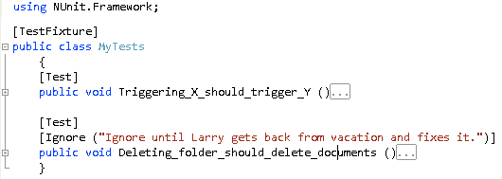
Extensible metadata in .NET
.NET Custom Attributes “extend” classes, properties, methods, etc with custom metadata...
Each custom attribute is defined by a .NET class that derives from System.Attribute
Notes:
So, in .NET you define custom attribute class by deriving System.Attribute then you can use it to extend your class, properties, methods etc.

Slide 12
ECCustomAttributes extend Metadata in ECObjects
An “ECCustomAttribute ECClass” is an ECClass with IsCustomAttribute = true.
Attach ECInstances of an ECCustomAttribute to ECClasses, ECProperties, and ECSchemas to extend them.
ECSchema
Pump
(InstanceId=47)
ECClass: Units
IsCustomAttribute=true
ECClass: Pump
AssetTag (string)
Manufacturer (string) PressureDrop (double)
Flowrate (double)
P-101
GE 4.5 psi
9.7 gpm
UnitName (string)
Units
UnitName = PSI
Units
UnitName = GPM
Notes:
Similarly, for EC, you need to define our regular ECClass. Set IsCustomAttribute=True.
Here is an example:
We will define new ECClass: Units. Mark IsCustomAttribute=true. Have a property UnitName
Now take our Pump ECClass.
Attach UnitClass to PressureDrop property, set UnitName = PSI
Attach UnitClass to FlowRate property, set UnitName = GPM
Now, when we have ECInstance of Pump, we should see pressureDrop value with unit like 4.5 PSI, same with FlowRate property.
These custom attribute definition and application, is confined to ECSchema. And, type converters or some other code needed to comprehend custom attributes and manipulate ECPropertyValue or ECInstances accordingly.

Slide 13
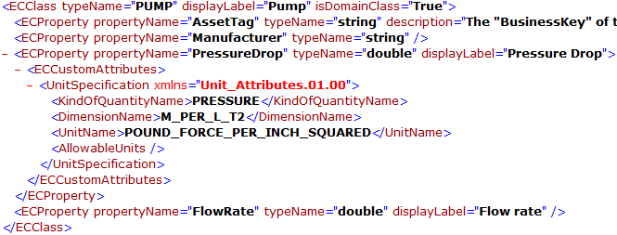
ECCustomAttributes in ECSchemaXML
Notes:
After extending property, our schema ECXML will look like this. Unit specification custom attribute class instance is wrapped under ECCustomAttributes tag.

Slide 14
Examples of ECCustomAttributes
UnitSpecification
CalculatedECPropertySpecification
BusinessKeySpecification
InstanceLabelSpecification
Display metadata (e.g. “Category” for an ECProperty)
Mapping to other systems (e.g. a database table)
Name of a .NET class to supply “behaviors” for ECInstances.
Notes:
Here are standard list of custom attributes EC offers.
UnitSpecification – for defining units for numeric properties
CalculatedECPropertySpecification – for Calculated Properties
BusinessKeySpecification – for business key property
InstanceLabelSpecification – for instance label in UI
Display metadata – for Categorizing EC properties and sorting in Property Pane UI.
Mapping to other systems (e.g. a database table)

Slide 15
ECRelationshipClass
Like DB “link table”
Is an ECClass
Strength (Referencing, Holding, Embedding)
Source and Target
Constraints (Which class? Polymorphic?)
Cardinality on this “end”
RoleLabel (when “reading” starting from this end)
“holds” from source end
“is held by” from target end
<ECRelationshipClass typeName="WidgetHasGadgets" description="WidgetHasGadgets" strength="referencing">
<Source cardinality="(1,1)" roleLabel="has Gadgets" polymorphic="False">
<Class class="Widget" />
</Source>
<Target cardinality="(1,N)" roleLabel="are held by Widget" polymorphic="False">
<Class class="Gadget" />
</Target>
</ECRelationshipClass>
Notes:
ECRelationship is special type of ECClass who links two ECInstances. It matches the way the database links two tables.
ECRelationship class has following attributes:
Strength -> has three values. Referencing: whether source instance refers to target. Holding: whether source instance holds target instance. Embedding: whether source instance embeds target instance.
Source and target constraint: has following attributes
cardinality: we will talk about this in coming slides.
RoleLable: Describes role of constraint
Polymorphic: whether constraint class is polymorphic or not.
& Constrain Class.
Here we have example relationship, WidgetHasGadgets. Where Source constraint class is Widget and Target constraint class is Gadget.
Cardinality of our relationship is 1 to Many.

Slide 16
Cardinality
Bentley.ECObjects.Schema.StandardCardinality
OneOne (1,1)
ZeroOne (0,1)
ZeroMany (0,n)
OneMany (1,n)
Only referring to one “end” of the relationship!
A one-to-one ECRelationship will have
source cardinality of (1,1)
Target cardinality of (1,1)
A one-to-many ECRelationship will have
source cardinality of (1,1)
Target cardinality of (1,n) or (0, n)
Notes:
Cardinality shows, in what number source and target instances relates to each other. There are four type of cardinality values. OneOne ZeroOne, ZeroMany, OneMany
Cardinality refers to one end of relationship.
So, one-to-one relationship will have, source cardinality as (1,1) and target cardinality as (1,1)
And, one-to-many relationship will have, source cardinality as (1,1) and target cardinality as (1,n) or (0,n)

Slide 17
ECRelationships
Constraint
Relationship
Class: R
Constraint
Class: A
Class: B
Pointer
Relationship: R1
- property values
Pointer
Instance: A
- property values
Instance: B1
- property values
Relationship: R2
- property values
Instance: B2
- property values
Relationship: R3
- property values
Instance: B3
- property values
Like a “row” in a link table
Allows property values
Notes:
Consider we have Class:A and Class:B. They are related to each other via Relationship, Class R.
Now, say you have instance A of Class A and Instance B of Class B. And you need to establish relationship between them. So, you create relationship instance R1. And point Instance A to Source side and Instance B1 to Target side. Now, say we have cardinality at Source as (1,1) and for target (1,n) i.e we want to achieve one-to-many relationship. And you have 3 instances of B i.e. B1, B2 and B3 and only one instance of A.
Here, you need to create three instances of Relationship class R, i.e. R1,R2 and R3. For each relationship instance, you will assign instance A at source and at target side you, will assign instances of B.
R1 => at source A -→ at target B1
R2 => at source A -→ at target B2
R3 => at source A -→ at target B3

Slide 18
ECRelationshipInstances
Hold a reference to the source ECInstance and target ECInstance
Like a “row” in a link table
In a one-to-many relationship where “many”=3, there will be 3 ECRelationshipInstances
Notes:
So, ECRelationship instance holds reference to source instance and target instance. It represents a row in a link table.
Now, in case of one-to-many relationships, If we have one source instance and 3 target instances, there will be 3 relationship instances, where source of each relationship instance will point to common source and target of each relationship will point to each individual relationship instance.

Slide 19
ECObjects Implementations
.NET
Default implementation of IECClass (ECClass) and IECInstance (ECInstance), etc.
EC delegates get/set to other object.
Native-backed
C++
One concrete implementation of ECSchema/ECClass
Abstract base class IECInstance with one default implementation and other implementations in DgnEC
In both .NET and C++
XML serialization/deserialization
Binary serialization/deserialization
Notes:
ECObject implmentations:
For .NET, we have default implementation for IECClass (ECClass) and IECInstance (ECInstance), EC delegates like get/set to other object, Native-backed or MixedMode implementations.
For C++, we have one concrete implementation of ECSchema/ECClass. Abstract base class IECInstance with one default implementation and other implementations in DgnEC
For both .NET and C++: we offer XML and Binary serialization/deserialization

Slide 20
ECObjects in DGN
V8i (.NET Only)
An XAttribute (blob on a DgnElement) that holds an ECInstance (serialized to binary)
ECXAttributes.NET API
PropertyManager (data from ECPropertyEnablers)
DgnECPlugin (extend via PersistenceStrategies)
CONNECT (.NET and C++)
DgnECManager.native
DgnECManager.NET
DgnECPlugin3
Notes:
In V8i: we had Xattributes (blob on a DgnElement) that holds an ECInstance (serialized to binary). You need to scan elements, fetch Xattributes and use ECXAttributes.NET APIs to convert Xattributes to EC. Many APIs may not be available.
Alternatively, you can use managed DgnECPlugin to query EC information. Also we have property enablers.
In CE, still EC is persisted on elements via Xattributes. However, we have comprehensive DgnEC APIs to query EC information from Microstation Elements.

Slide 21
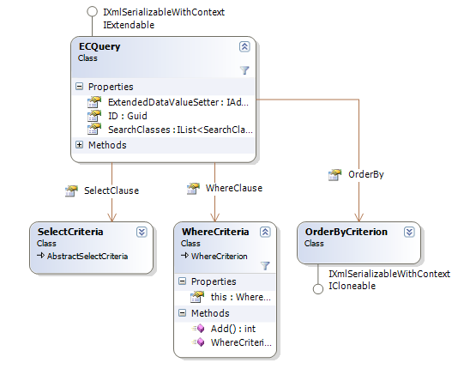
ECQuery
Conceptually similar to SQL Queries
Not a text format, but an object graph
Notes:
ECQuery is interface EC is providing for query EC information from your datastore. It’s conceptually similar to SQL queries. However its an object graph, it’s not in TSQL format.
For ECQuery, you need to specify:
Search Classes: which define, instances of which ECClasses you are looking for.
Select Criteria: if you want related instances of searchclass instances, you need to specify select related criteria.
Where criteria: here you need to specify where criteria's.
OrderBy criteria: here you can specify ordering criteria for results.
We will learn more about ECQuery, during DgnEC API chapter.

Slide 22
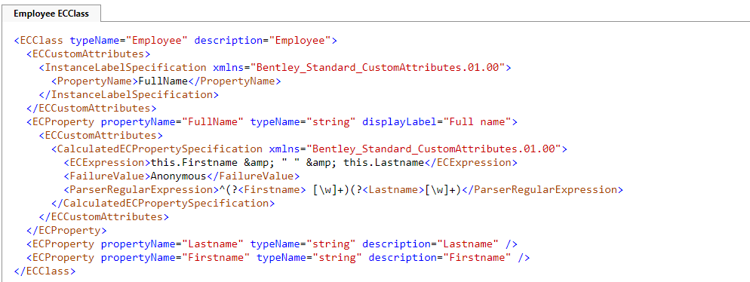
EC Expressions
An ECExpression is an interpreted expression language with first class access to the values of ECInstances
ECExpressions are designed to be easy to write and guaranteed to not crash the application if they fail
One of its many uses is as the language for calculated properties.
Notes:
An ECExpression is an interpreted expression language with first class access to the values of ECInstances.
From Microstation U14, we are introducing ECExpression support for ItemTypes. We will learn it in detail during ItemType sessions.

Slide 23
Further readings
Please refer to ECObjects.chm in SDK.
Please refer to DgnEC training session
Notes:
For further learnings, refer to ECObjects.chm in SDK. Also, please watch DgnEC training session for learning actual EC APIs.

Slide 24
For more information
Developer Portal
Developer.Bentley.com
Programming Community
Communities.Bentley.com/products/programming
MicroStation Programming Community
https://communities.bentley.com/products/programming/microstation_programming/
MicroStation Programming Blog
https://communities.bentley.com/products/programming/microstation_programming/b/weblog
MicroStation SDK Help in installed location
C:\Program Files\Bentley\MicroStationCONNECTSDK\Documentation
Notes:
Here are some key links to get started and get additional help.
you can get a lot of samples and documentation on your own computer in the location where the SDK is installed.

Slide 25

Connect with Bentley
Connect with us
www.bentley.com
developer.bentley.com
communities.bentley.com/products/programming
Social Media
Medium.com
MicroStation CONNECT Edition
MicroStation CONNECT Edition SDK
Notes:
Make sure to Connect and Follow Us on Social Media by clicking on links related to: Bentley, its Software Developer Program, or MicroStation and PowerPlatform SDK!
Thank you!

